Slide 1

Extreme Programming
Prepared By:
Aashish Tamrakar
Asim Aryal
Niroj Bajracharya
Sudip Gyawali

Slide 2
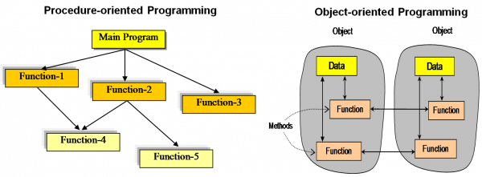
Rise of Extreme Programming
In 1990s, Object Oriented Programming replaced procedural programming.
Notes:
START OF AASHISH! (RISE OF CONCEPT)

Slide 3
Rise of Extreme Programming
Internet changed the business requirement to rapidly changing.
KENT BECK
Dot Com Bubble
↑ Internet rose
Development
Time ↓

Slide 4
eXtreme Programming (XP) - Introduction
Software development model
Waterfall model
Iterative model
Agile model
RAD model
Incremental model
V model
Spiral model
XP
Extreme Programming
Agile model
FDD
Feature Driven Development
ASD
Adaptive Software Development

Slide 5
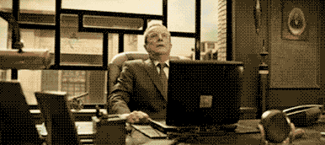
Extreme Programming - Introduction

Slide 6
Extreme Programming (XP) - Introduction
Extreme Programming can be defined as: software development model intended to improve software quality & responsiveness to changing software requirements.
In XP, there are shorter software development cycles where checkpoints can be incorporating new software requirements.

Slide 7
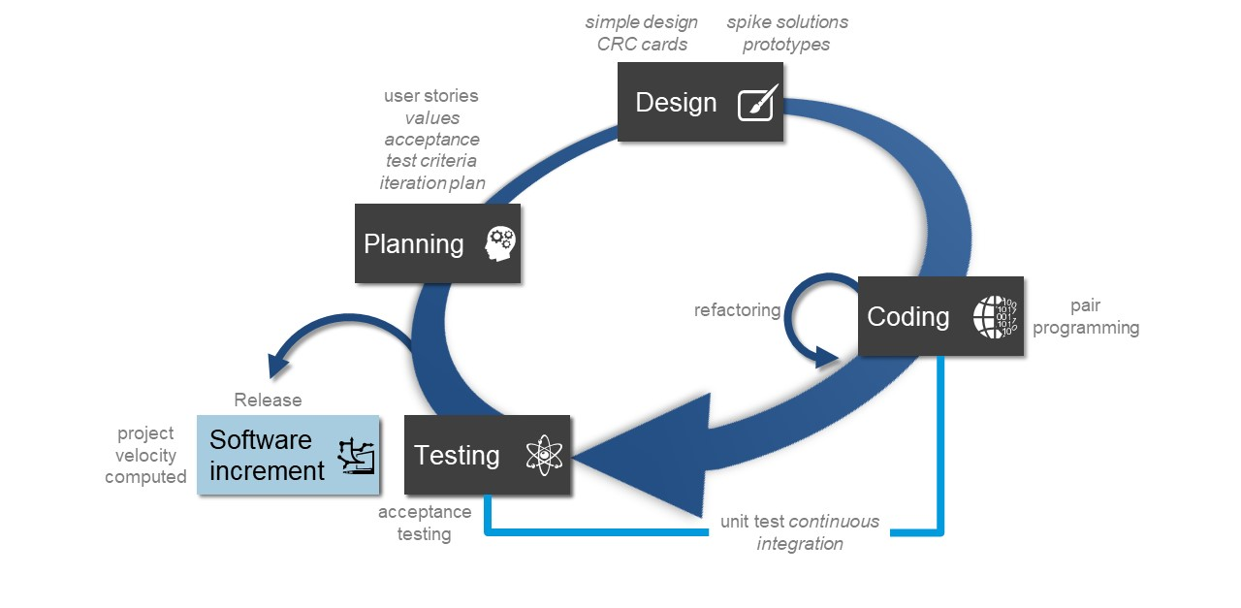
Extreme Programming (XP) - Diagram

Slide 8
Individually, it doesn’t make sense
Managing
Planning
Designing
Coding
Testing

Slide 9
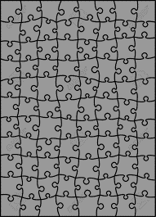
Combined, it makes XP
X
e
treme
Programming

Slide 10
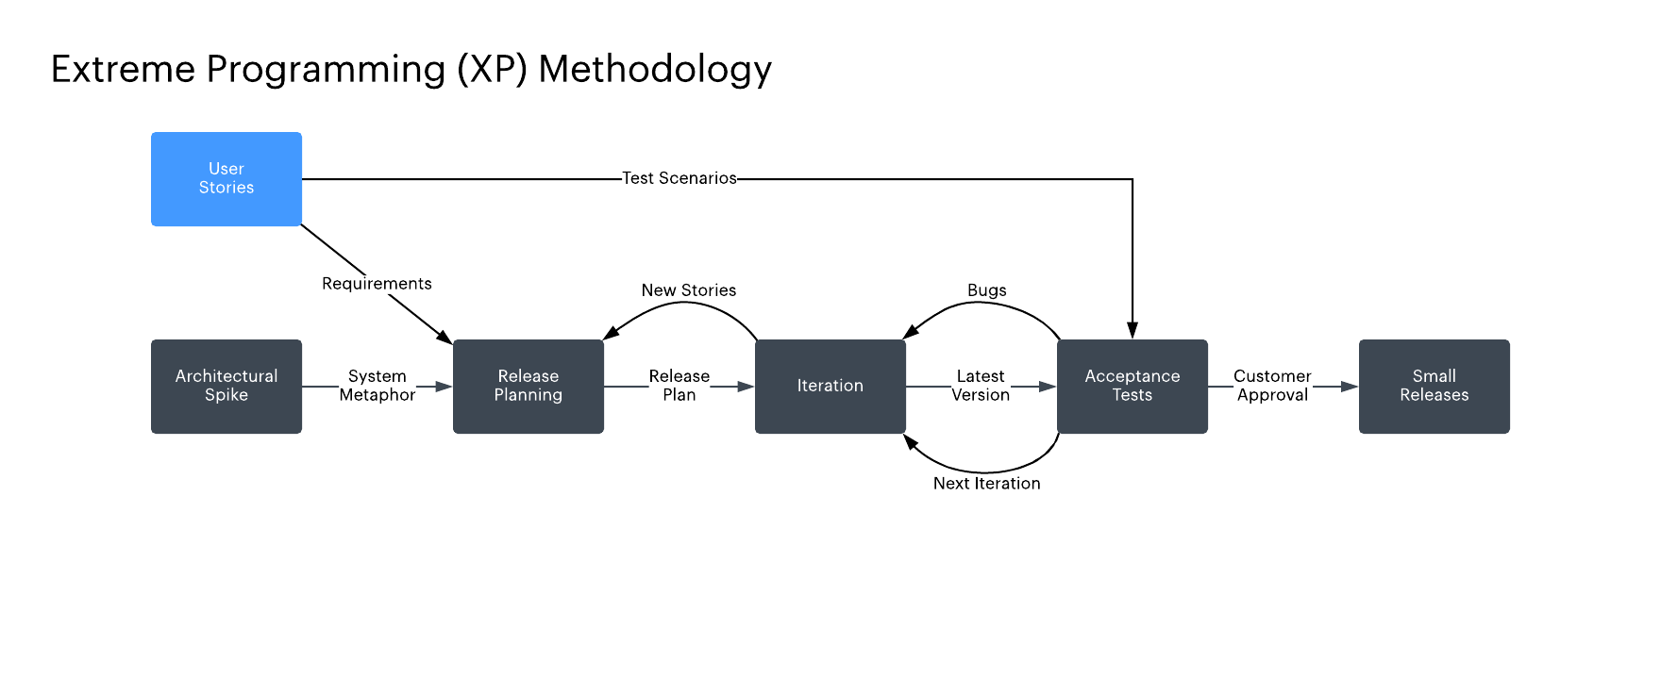
Extreme Programming (XP) - Diagram

Slide 11
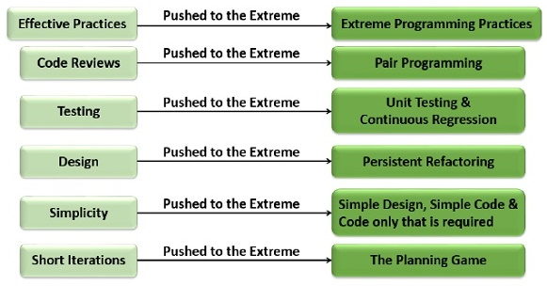
Why Name “Extreme Programming”?
Notes:
END OF AASHISH! (Why XP?)

Slide 12
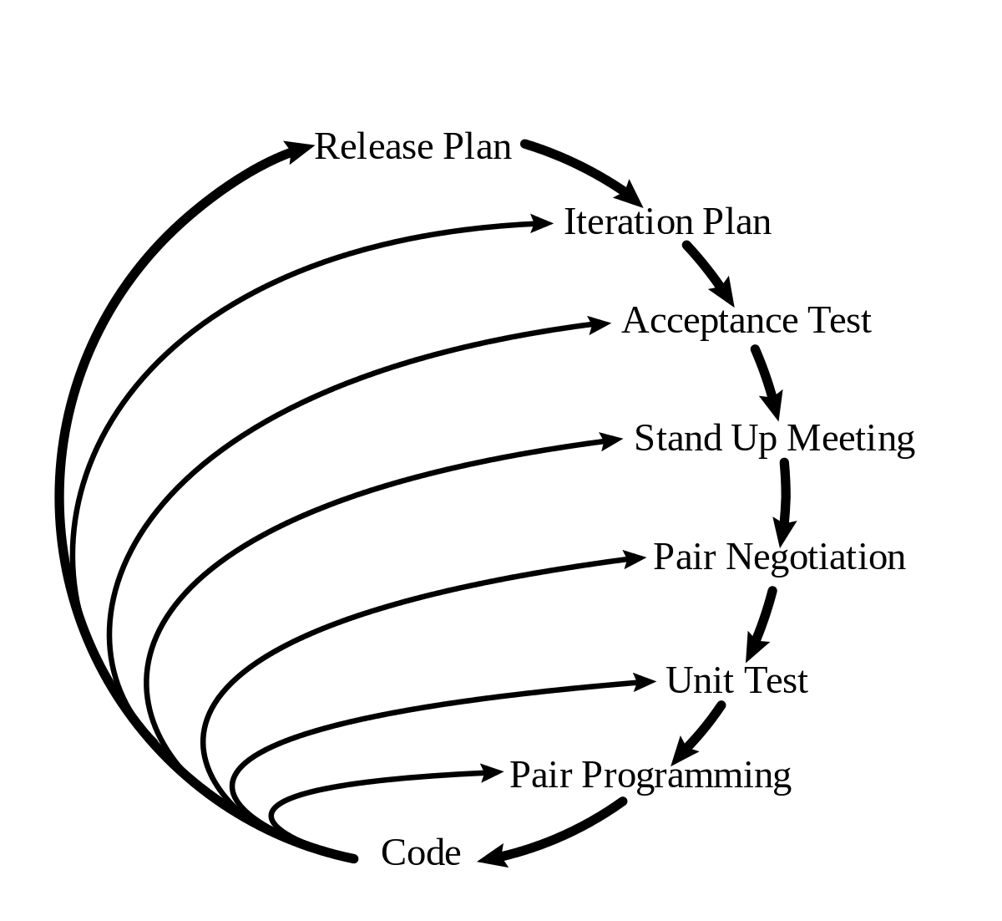
Features of XP
Code review
Pair programming
Testing
Quick Releases
Refactoring
Metaphor
Notes:
*distinct aspect
*feedback loop

Slide 13

Pair Programming
Knowledge is shared.
less error , more efficient.
Expert and novice pairing.
Notes:
*Driver and Navigator
*learn from each other
*improve readability
*changes bad coding habit
*cons

Slide 14
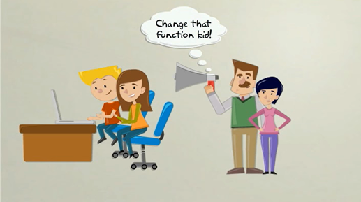
Code Review
To improve the code and find error.
Continuous process of improvement.
Clean and Efficient code.
Notes:
*more applicable
*pair requires two people
*remote code review

Slide 15
Testing
code2
code1
Code 3
code4
Unit Testing
Unit Testing
Unit Testing
Unit Testing
testedcode2
testedcode1
testedcode3
testedcode4
Acceptance Testing
Unified Code
Notes:
*Huge program divided into small codes
*Reduces error
* First code1 and 2 is merged

Slide 16

Metaphor
Simple expressive description of how the program works
Replaces standard project architecture.
Should be understand by the customer.
Notes:
*improve transparency of the project
Customer will have faith in project
* Show progress of project

Slide 17
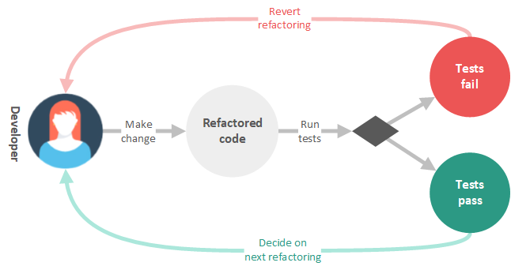
Refactoring
Changing of code interval behavior without changing its external behavior.
Intended to improve non functional attributes
Notes:
* Most important functional req
* After initial release

Slide 18
Values
Values
Communication
Feedback
XP VALUES
Simplicity
Respect
Courage
Notes:
*Moral obligation of programmer towards the project and everyone involved

Slide 19


Communication
Communication between all the involved members.
Duplex Communication
Customer
customer
Feedback
Notes:
**customer gives requirement *team sport
*discussion with different teams *onsite
* After each iteration customer talks ui functional and non functional requirements

Slide 20



Respect
Mutual respect between developers for peaceful working environment.
Notes:
* provide and accept feedback that honors your relationship
*no crossing boundary.*workplace discipline

Slide 21


Courage
Courage to respond to changes.
Notes:
*accept and act on feedback, even when it’s difficult to accept.
* courage to stop doing something that doesn’t work
*courage to raise organizational issues that reduce your team’s effectiveness
*Simplicity Do nothing Unnecessary

Slide 22
ADVANTAGES
Fewer documentation required
Fast delivery
Higher-quality code

Slide 23
ADVANTAGES
Easy to manage
Collaboration with customer

Slide 24

DISADVANTAGES
Focused only on code
Requires much user input
Depends on customer interaction
Works only in smaller project

Slide 25


Lack of structure and necessary documentation
Requires too much cultural changes to adopt
Works with senior-level developers
CRITICISMS
Notes:
`

Slide 26


Controv
e
r
s
y
More manpower
Adaptation Difficult
Customer Guided Design
Over Budget

Slide 27

Application
Co-located
extended
development
team
Automated
Technology
Dynamically
changing
software
requirements
Risks caused
by fixed
time project

Slide 28




Roles
DEVELOPER
MANAGER
COACH
CUSTOMER

Slide 29
Customer
Source of problems
What to program
Give every bit of your idea to your developer
Develop positive attitude
Functional testing

Slide 30


Functional Testing
I will have the test ride.

Slide 31
Developer’s Skills
Pair Programming
Communication
Code only what is required.
Maintain simplicity
Collective Ownership
Perform unit testing
Refactor

Slide 32
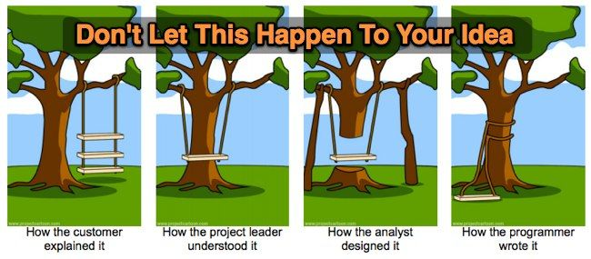
Need of understanding

Slide 33

Manager’s Task
Monitor the project, fix any deviations, modify the rules if and when required.
Tracking the time spent
Looking after developer team

Slide 34
Coach
New teams need coach.
Understanding whole idea of project.
Remain calm even when everyone else is panicking.
Be ready to help.
Be the shadow for team.

Slide 35
THANK YOU!

Slide 36


?

